Slide 1


Global Water Partnership – Mediterranean (GWP – Med)
DEVELOPMENT OF THE SECTOR FLOOD RISK MANAGEMENT POLICIES IN THE DRIN BASIN
(AGRICULTURE AND ENERGY)
In the framework of the: “The Integrated Climate-Resilient Transboundary Flood Risk Management in the Drin River Basin in the Western Balkans” (Drin FRM Project)
Pointpro Consulting, 12 Oct 2023

Slide 2
Aim and Objectives
The main objective of this assignment is to analyze interconnected dependencies, conflicts, and options for policy coordination between the sectors of flood protection and hydropower, and agriculture in the Drin basin by developing sectoral policies. Also with this assignment, tangible climate-resilient non-conventional measures for mainstreaming into existing national frameworks will be analyzed.
TASK 1
Prepare for development of the Sectoral policies, data collection and processing
TASK 2
Develop two technical studies on climate change impacts on energy (hydropower) and agriculture in the flood-prone areas of the Drin River basin
TASK 3
Develop sectoral FRM policies and any necessary enabling guidelines and/or tools for sectors of Agriculture and Energy (Hydropower)
The aim of Task 1 is to provide expert support for the further development of the Sectoral policies. In the first phase, all relevant secondary data which has been used in the past will be provided (flood hazard and risk maps, national policies documents in relation to Hydropower and Agriculture, and national climate adaptation policies in related sectors). The primary data relevant to the assignment will be collected in two phases. Initially by applying quantitative techniques, such as Time Series Analysis, Smoothing Techniques as well as Barometric Method (a method to speculate future trends based on current developments), a series of data related to electricity production, management of reservoirs, as well as data related to agricultural production, the crop patterns, yields ... will be provided. In the second step, in order to obtain feedback (needs and expectations) from the stakeholders, qualitative techniques will be applied such as (1) Interviews, (2) Focus Groups, and (3) Questionnaires.
The main focus of Task 2 will be developing of in-depth technical analysis of the Agriculture and Hydropower sectors related to floods by taking into consideration the climate change effects.
REFERENCE Scenario
CLIMATE CHANGE Scenario
FLOOD PROTECTION Scenario
FLOOD-SMART OPERATIONS and ACTIONS
Within this task, the Consultant will develop policies for the Agriculture and Hydropower sector which will provide mitigation recommendations for the flood-prone areas of the Drin basin. Each of the policies will contain general recommendations as well as site-specific technical recommendations to tackle climate change.

Slide 3
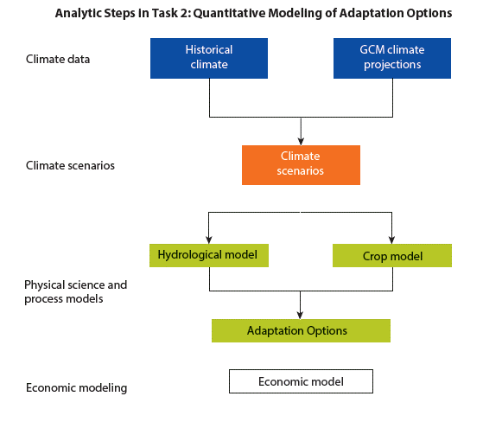
DEVELOPMENT OF THE SECTOR FLOOD RISK MANAGEMENT POLICIES IN THE DRIN BASIN (AGRICULTURE AND ENERGY)
TASK 1
Prepare for development of the Sectoral policies, data collection and processing
TASK 2
Develop two technical studies on climate change impacts on energy (hydropower) and agriculture in the flood-prone areas of the Drin River basin
TASK 3
Develop sectoral FRM policies and any necessary enabling guidelines and/or tools for sectors of Agriculture and Energy (Hydropower)

Slide 4
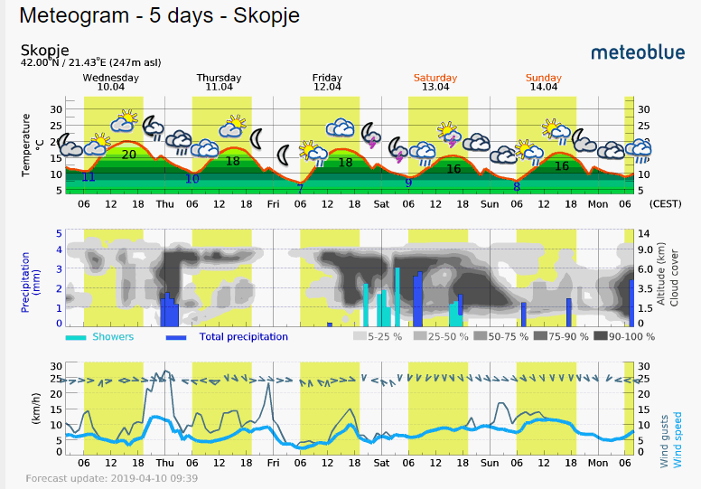
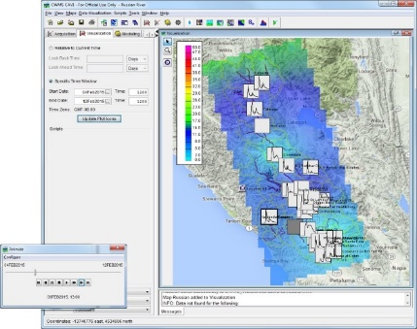
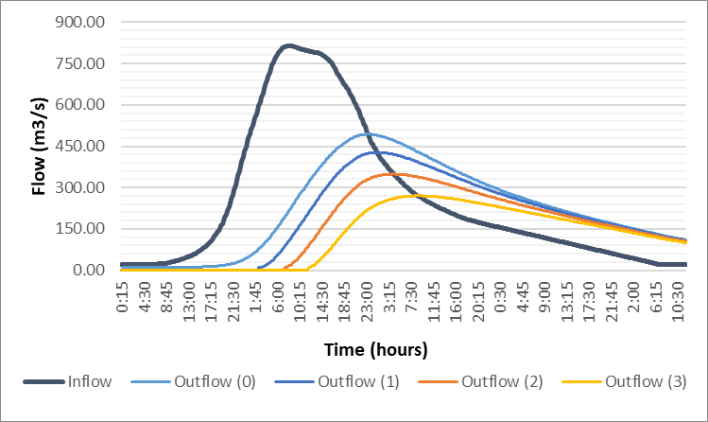
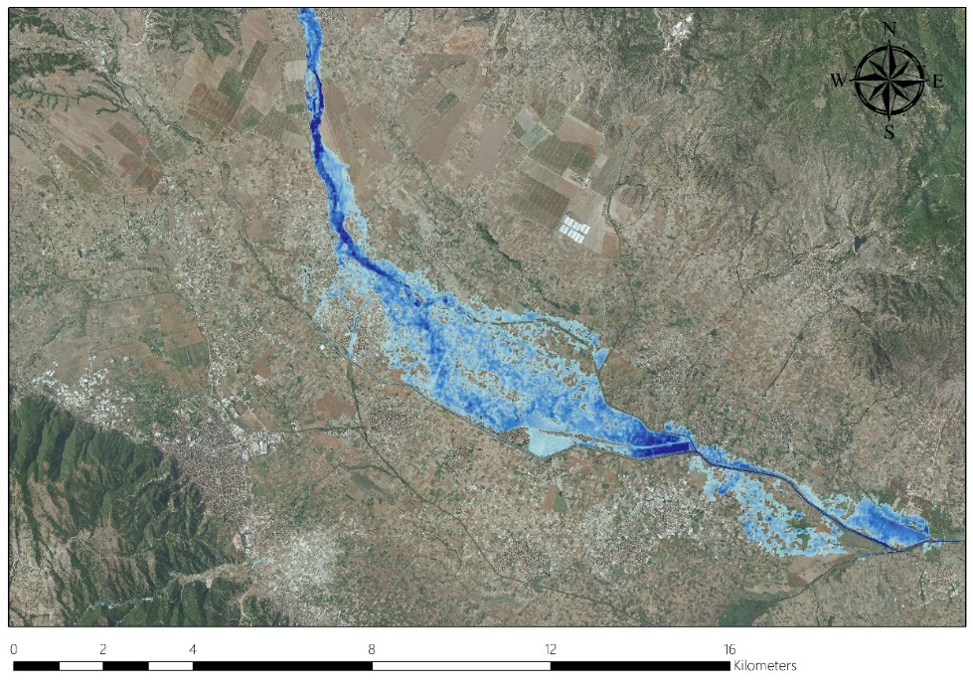
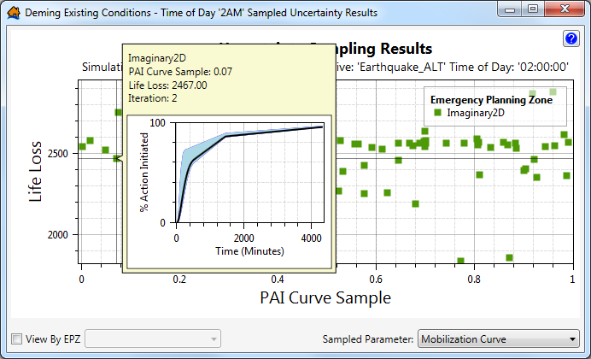
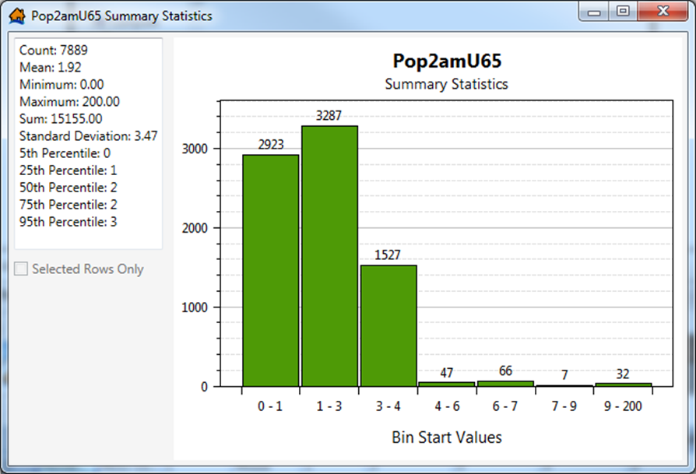
DEVELOPMENT OF THE SECTOR FLOOD RISK MANAGEMENT POLICIES IN THE DRIN BASIN (AGRICULTURE AND ENERGY)
Technical analysis of the Hydropower sector related to floods and climate change
METHODOLOGY
HYDROLOGICAL MODELING
Assessment of complete hydrologic processes
Assessment of complex watershed systems
Stochastic or Deterministic hydrologic modelling
Modeling of rainfall-runoff processes
Complex hydrological modelling
HEC-HMS
HEC-ResSIM
HEC-RAS
HEC-FIA
FLOOD IMPACT MODELING
Flood impact assessment
Calculation of flood damages
Spatial allocation of flood damages
Exposure and Vulnerability analysis
Critical infrastructure mapping
RESERVOIR - SIMULATION MODELLING
Assessment of flood reduction capacity
Assessment of peak flow reduction capacity
Assessment of energy production capacity
Assessment of various operational scenarios
Assessment of Climate change impact
Multi-purpose simulation analysis
HYDRAULIC MODELING
Two-dimensional flood modeling
Assessment of peak flows, water depths, velocity
Spatial modelling of maximum flood extents
Assessment of critical riverbed sections
Flood hazard and risk mapping
HEC-WAT (Watershed Analysis Tool)
A platform for connecting the models used in the analytical process
Integrating all created models into one management process
Simulation of various management policies
Analysis of potential flood damage and energy production

Slide 5
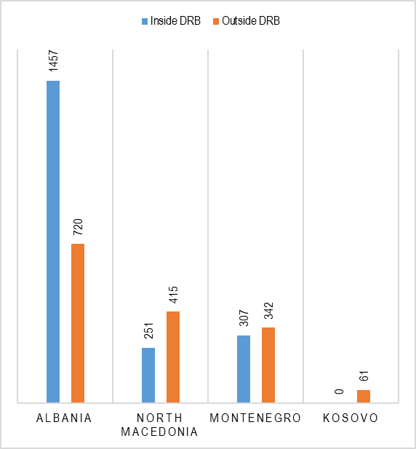
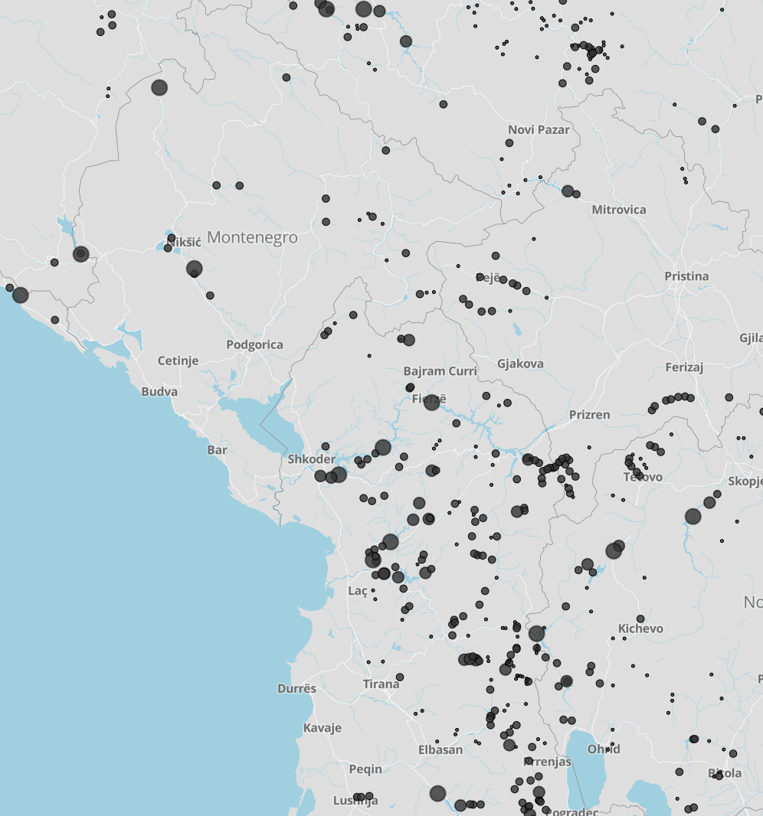
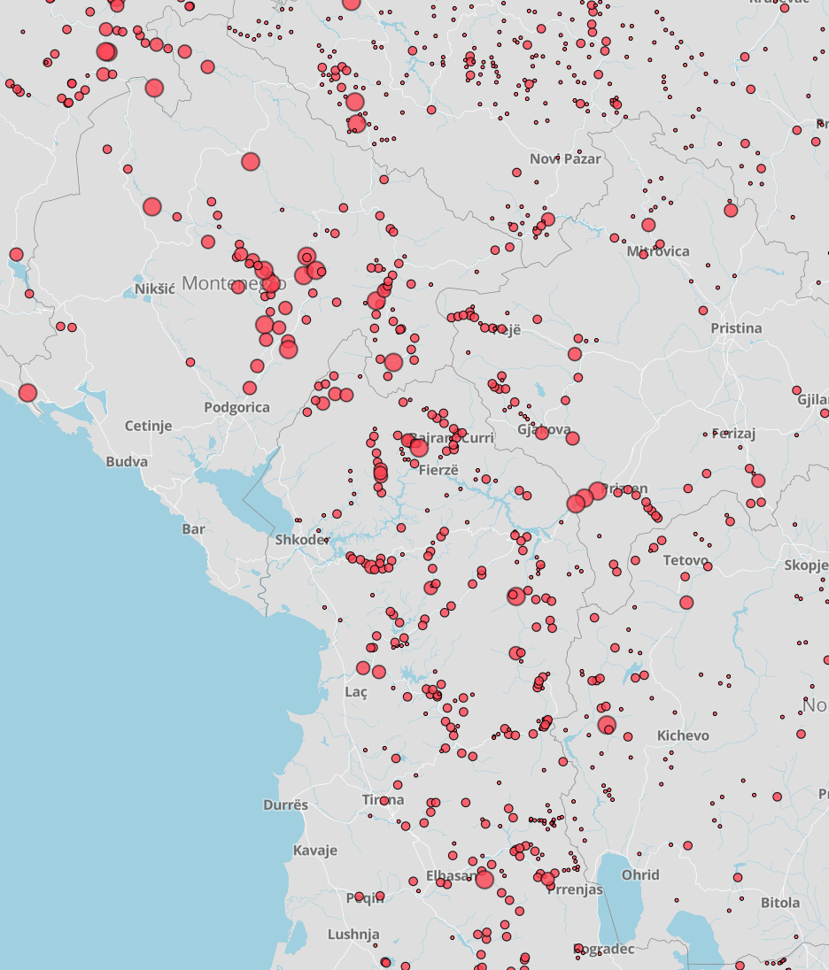
DEVELOPMENT OF THE SECTOR FLOOD RISK MANAGEMENT POLICIES IN THE DRIN BASIN (AGRICULTURE AND ENERGY)
Technical analysis of the Hydropower sector related to floods and climate change
HPP above 10 MW in the DRB
Country | Name | Owner | Operator | River | Year | Dam height (m) | Reservoir capacity (million m³) | Reservoir area (km2) | HPP coordinates |  | HPP Type | Instaled power (MW) | Annual production (GWh) | Source
 |  |  |  |  |  |  |  |  | East | North
North Macedonia | Mavrovo | State | ELEM | Mavrovska river | 1957 | 62 | 357 | 10.4 | 476908 | 4618294 | Run of river | 12.8 | 38 | http://www.elem.com.mk/?page_id=109
North Macedonia | Globochica | State | ELEM | Black Drin River | 1965 | 94.5 | 58 | 1.5 | 465371 | 4582637 | Reservoir | 42 | 180 | http://www.elem.com.mk/?page_id=109
North Macedonia | Shpilje | State | ELEM | Black Drin River | 1969 | 101 | 506 | 10.1 | 458524 | 4593651 | Reservoir | 84 | 272 | http://www.elem.com.mk/?page_id=109
Albania | Fierza | State | KESH | Drin River | 1978 | 161.5 | 2700 | NA | 420661 | 4678180 | Reservoir | 500 | 1300 | http://www.kesh.al/info.aspx?_NKatID=1111
Albania | Koman | State | KESH | Drin River | 1985 | 115.5 | 500 | NA | 402628 | 4661916 | Reservoir | 600 | 1800 | http://www.kesh.al/info.aspx?_NKatID=1112
Albania | Vau I Dejes | State | KESH | Drin River | 1970 | 60/54 | 580 | NA | 387051 | 4652191 | Reservoir | 250 | 1000 | http://www.kesh.al/info.aspx?_NKatID=1113
Albania | Ashta 1 | Private, consession | Verbund, EVN | Drin River | 2012 | 4.98 | NA | NA | 384115 | 4650958 | Run of river | 48.2 | 240 | http://www.energji-ashta.al/?id=9
Albania | Ashta 2 | Private, consession | Verbund, EVN | Drin River | 2012 | 7.53 | NA | NA | 380115 | 4652106 | Run of river |  |  | http://www.energji-ashta.al/?id=9
Montenegro | Peruchica | State, A2A | EPCG | Zeta | 1960 | 22.5/16.5/19.6 | 42/111/72 | NA | 335721 | 4726319 | Reservoir | 307 | 1300 | http://www.cedis.me/o-nama/hidroelektrana-perucica
Share of renewable energy sources in total energy consumption
 | 2020 | 2021 | Targets
Albania | 45.0% | 41.4% | 38%
Montenegro | 43.8% | 39.9% | 35%
North Macedonia | 19.2% | 17.0% | 23%

Slide 6
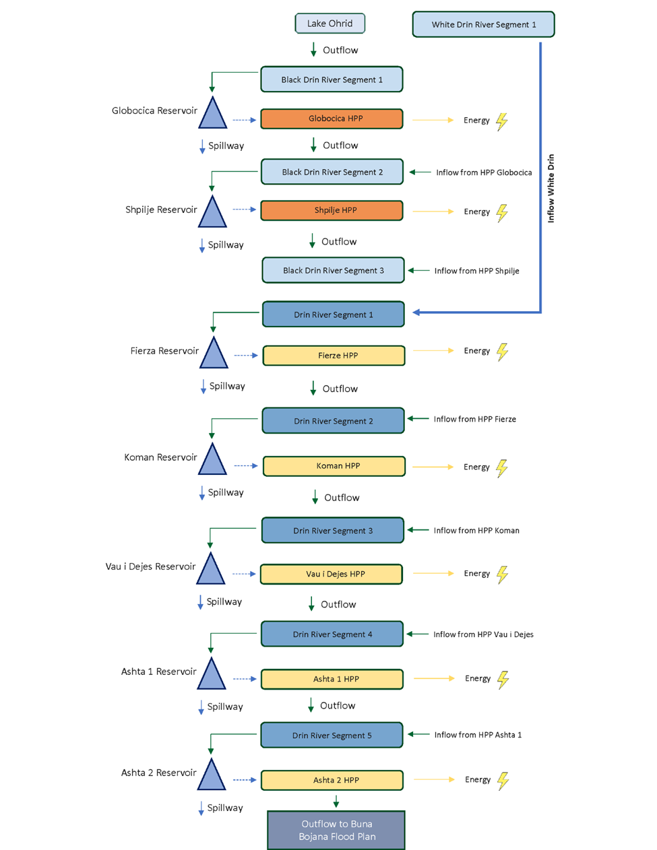
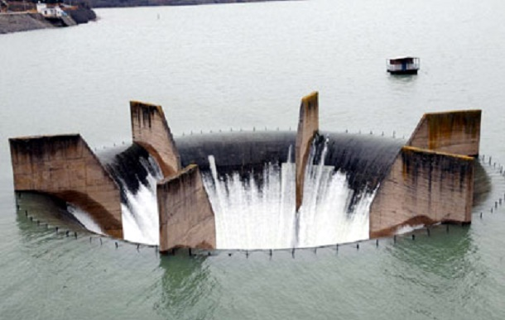
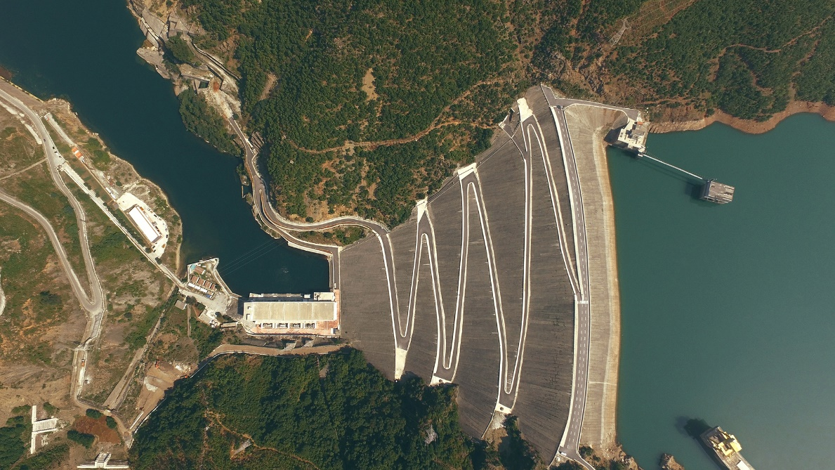
Shpilje HPP
Technical Design Indicators
Reservoir storage | 506 Mm3
Active reservoir storage | 218 Mm3
Number of Discharge Units | 3
Installed power | 84 MW
Mean Annual Production | 272 GWh
Lake filling year | 1969
Net head height | 85.2 m
Discharge Capacity | 108 (3×36) m3/s
Type of Discharge Unit | Francis
Fierze HPP
Technical Design Indicators
Installed power | 4×125 MW
No. & Type of Turbines | 4 Vertical “Francis”
Water Processing Cap. | 2×123.5 m3/sec
Mean Annual Production | 1,300 GWh
HPP Risk Rating | 1st Class
Construction Time | 1971-1980
Lake filling year | 1978
Dam Type | Earth Filled Clay Core
Geographical Position | V42°15’05”/L20°02’32”
Dam Height | 166.5 m a.s.l.
Dam Crest Level | 312.0 m a.s.l
Dam Crest Length | 380.0 m
Dam Crest Width | 13.0 m
Dam volume | 8 milion m3
Top Water Level | 296.0 m a.s.l.
Minimal Working Level | 240.0 m a.s.l.
Catchment Area | 11,829 km2
Mean Annual Flow | 202 m3/sec
Lake’s Total Volume | 2.7 billion m3
Lake’s Active Volume | 2.3 billion m3
Discharge Capacity | 2,670 m3/sec
Number of Discharge Units | 2
Type of Discharge Unit | Tunnels/Radial Gates

Slide 7
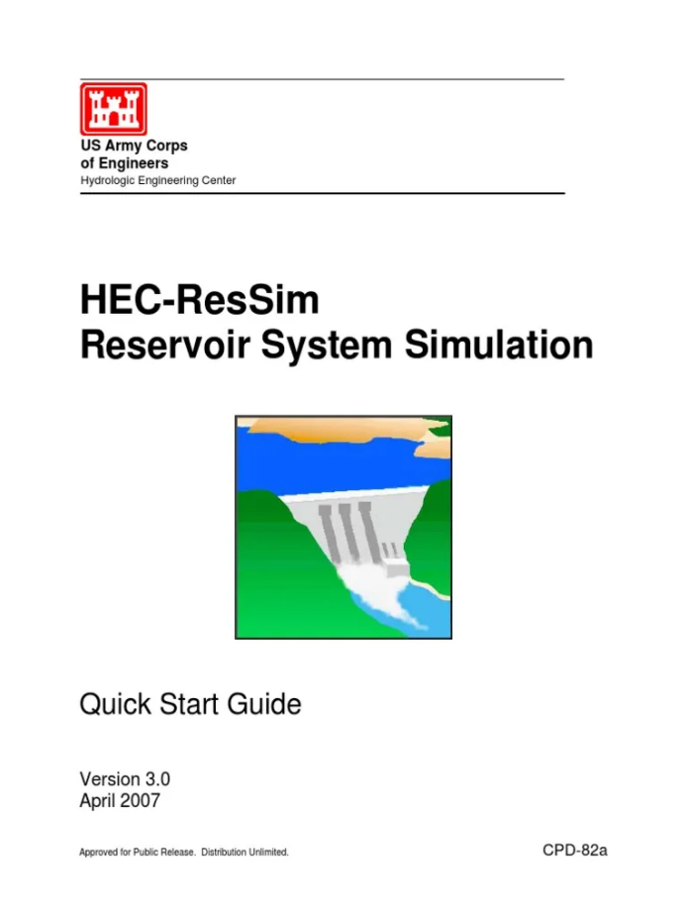
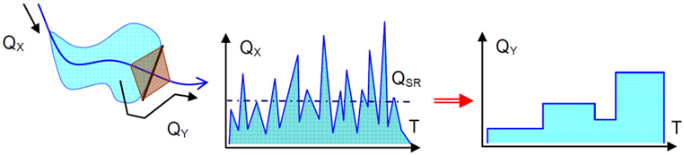
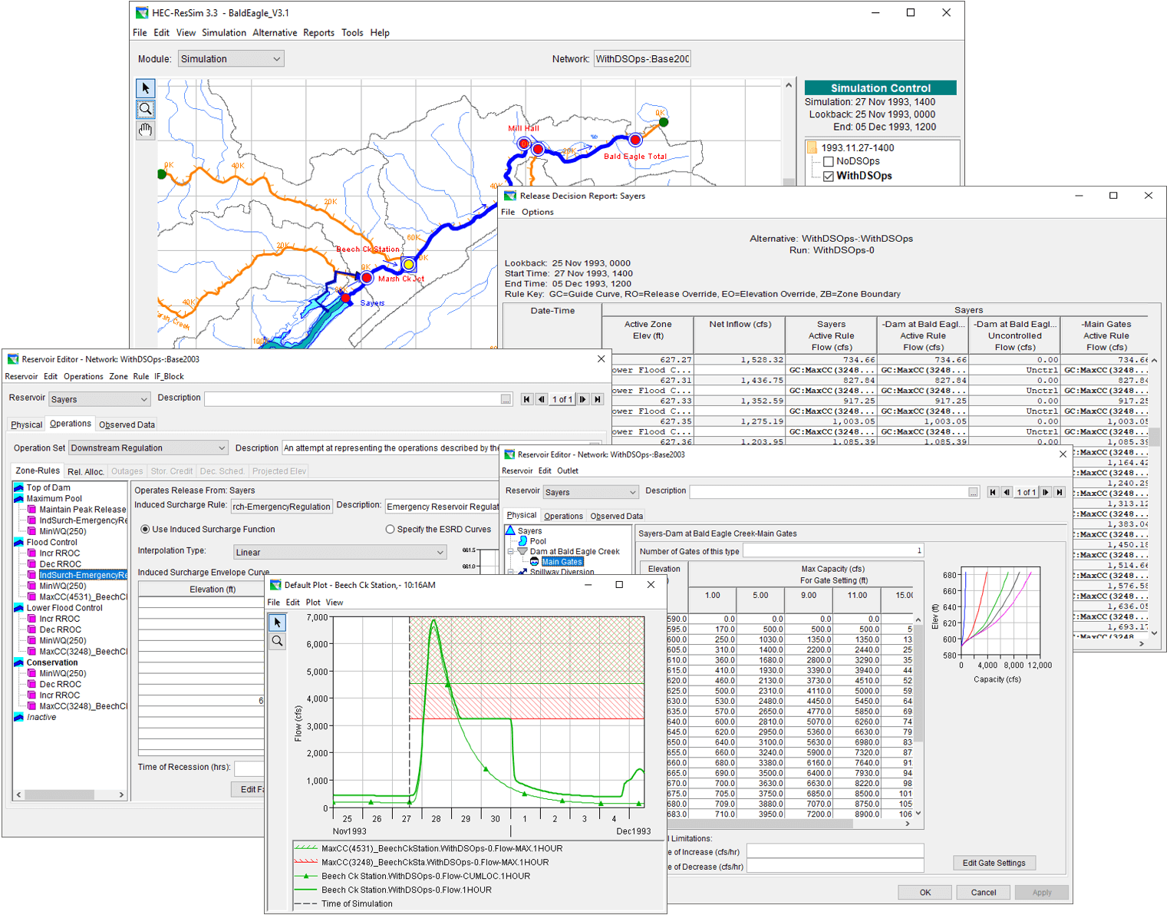
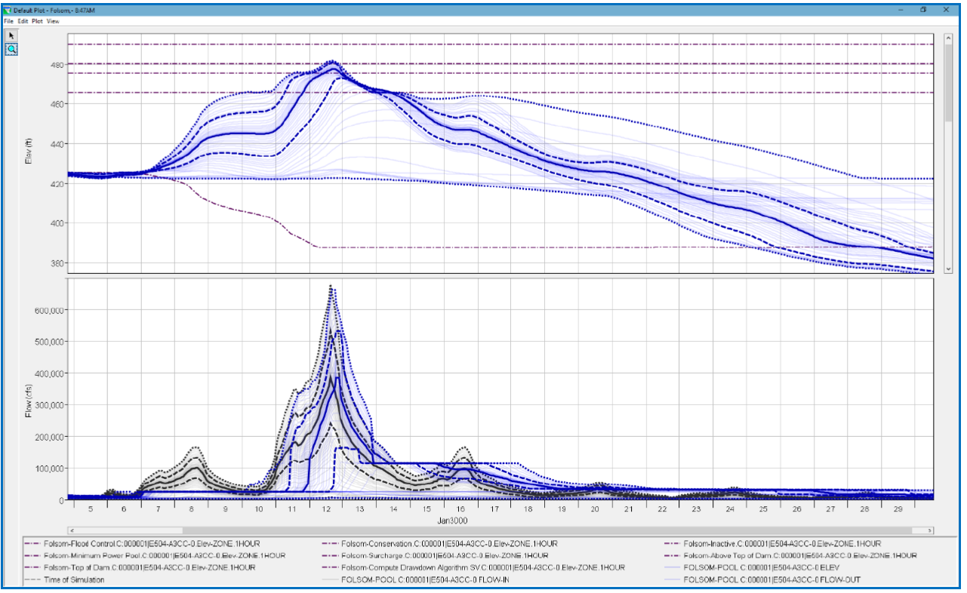
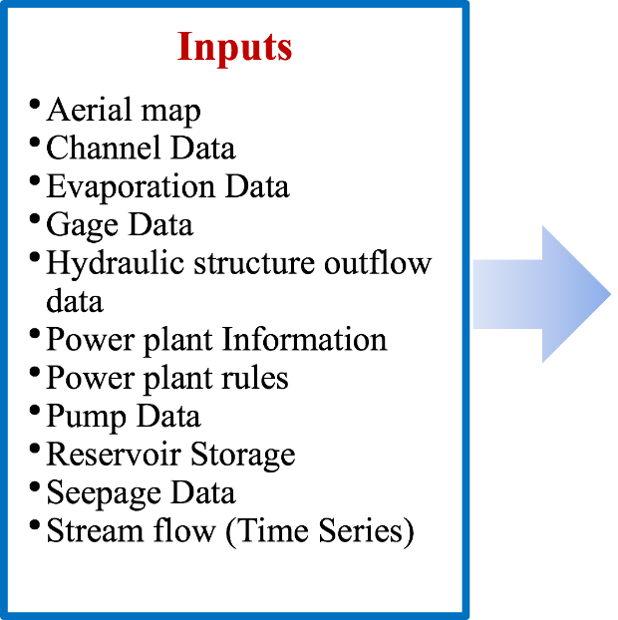
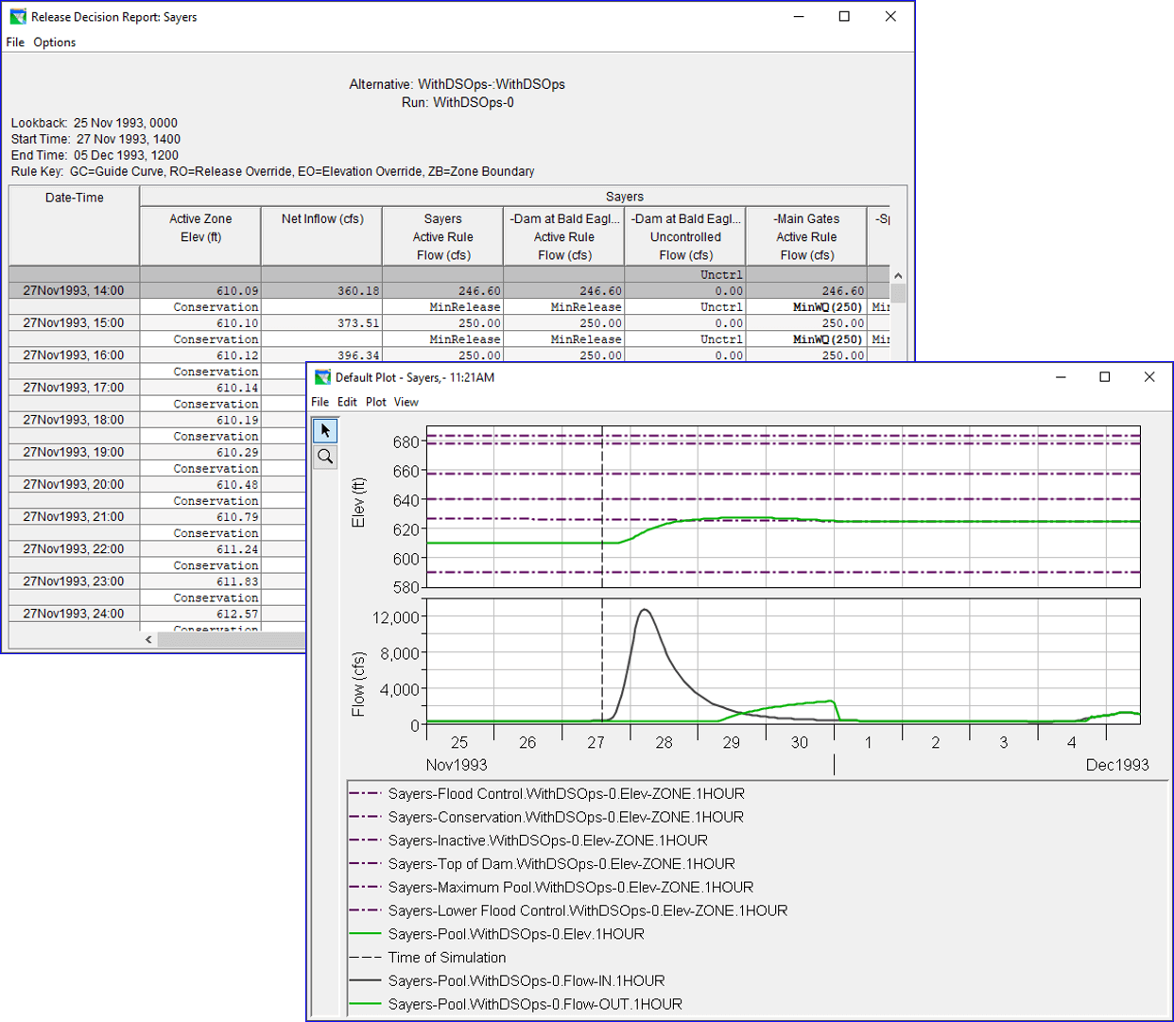
DEVELOPMENT OF THE SECTOR FLOOD RISK MANAGEMENT POLICIES IN THE DRIN BASIN (AGRICULTURE AND ENERGY)
Technical analysis of the Hydropower sector related to floods and climate change
HEC-ResSim is a reservoir simulation software which simulates reservoir operations for flood management, energy production, water supply for planning studies, detailed reservoir regulation plan investigations and real-time decision support.
The HEC-ResSim software was developed by the U.S. Army Corps of Engineers to model reservoir operations at one or more reservoirs for a variety of operational goals and constraints.
Graphical formulation of the reservoir operation simulation procedure
Graphical user interface (GUI) and utilizes the HEC Data Storage System (HEC-DSS)
Graphical plots of time-series variables, summary reports listing statistical output
Many pre-defined plots, tables and reports are available
Java code and graphical user interfaces
REFERENCE
CLIMATE CHANGE
FLOOD PROTECTION
FLOOD-SMART OPERATIONS and ACTIONS

Slide 8
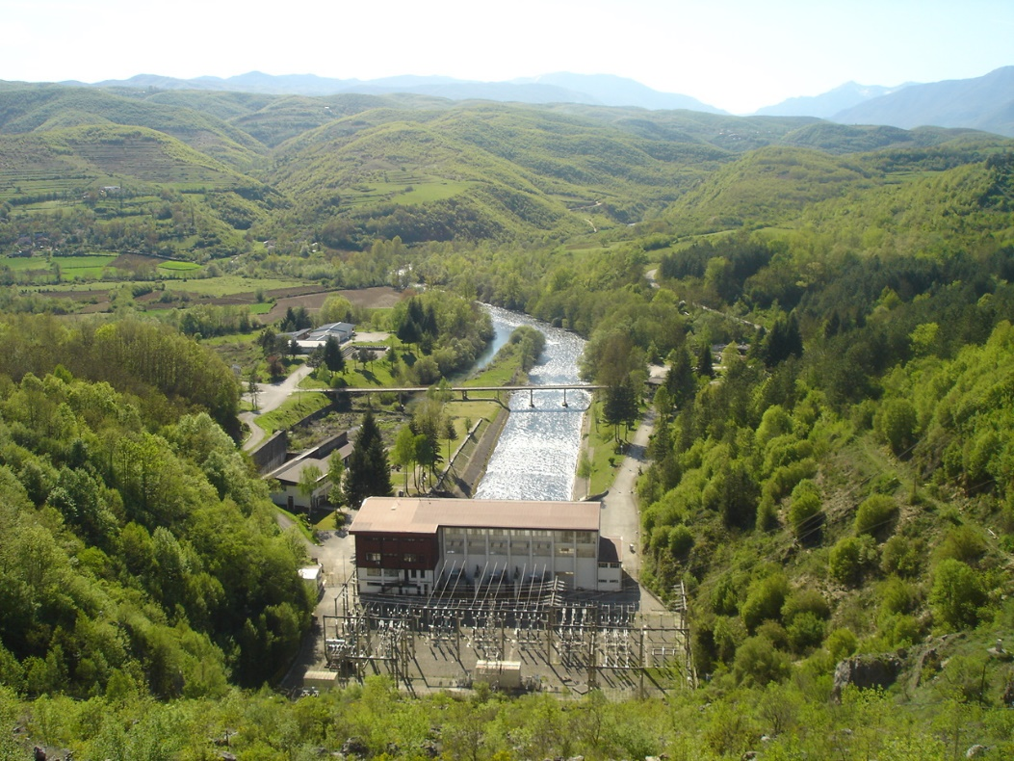
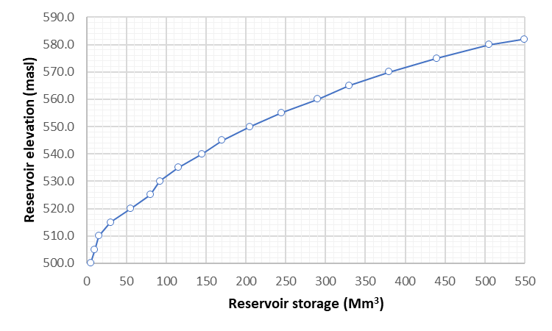
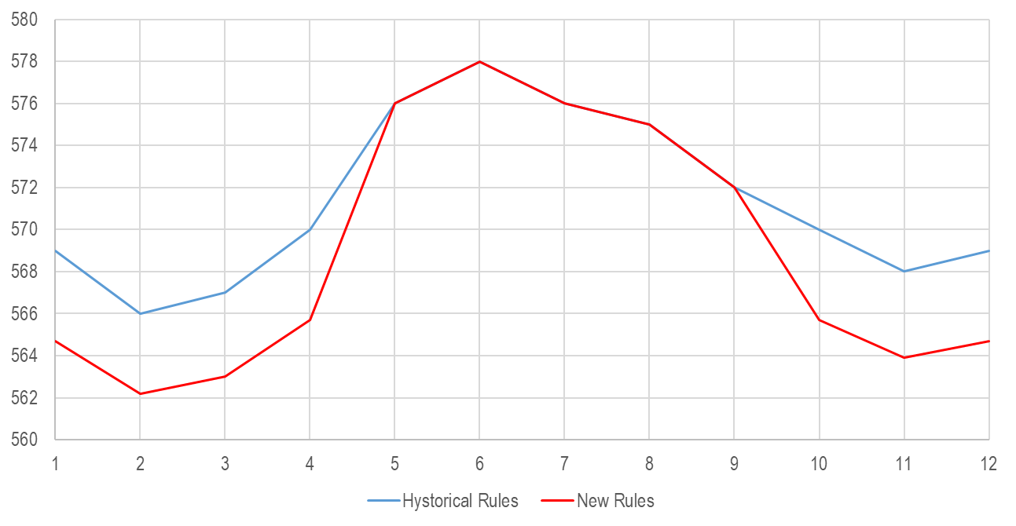
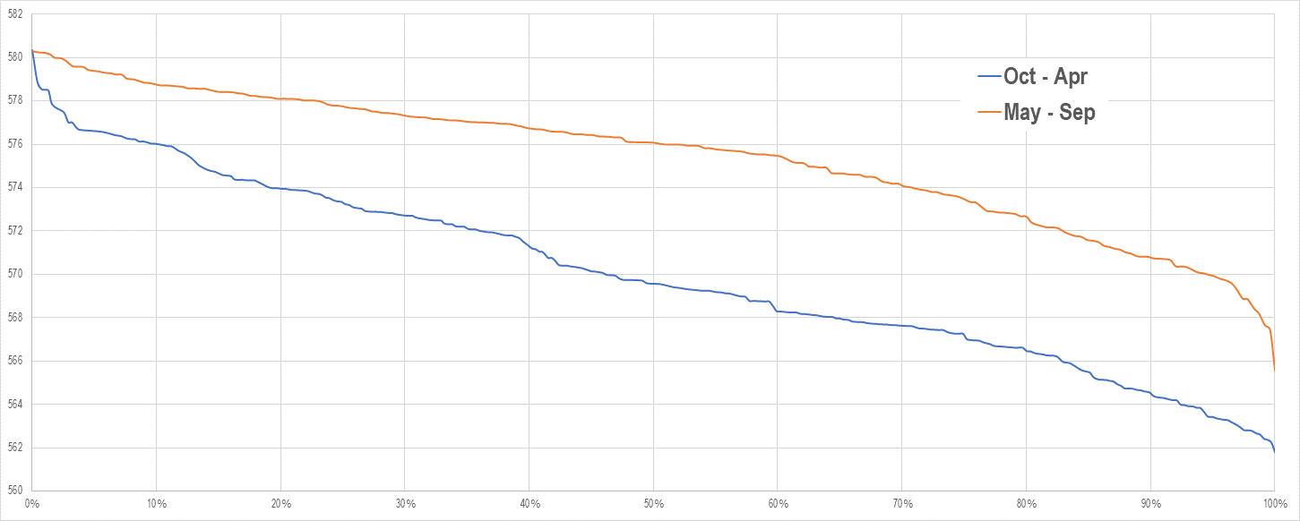
DEVELOPMENT OF THE SECTOR FLOOD RISK MANAGEMENT POLICIES IN THE DRIN BASIN (AGRICULTURE AND ENERGY)
Technical analysis of the Hydropower sector related to floods and climate change
Reservoir Simulation Modelling
Measured seasonal inflows
Measured seasonal energy production
Measured seasonal reservoir elevation
Power plant type, characteristics, capacity
Assessment of historical operation
Assessment of peak flow retention
Assessment of energy production capacity
Assessment of Climate change impact
Calibration and Verification of the model for HPP Shpilje

Slide 9

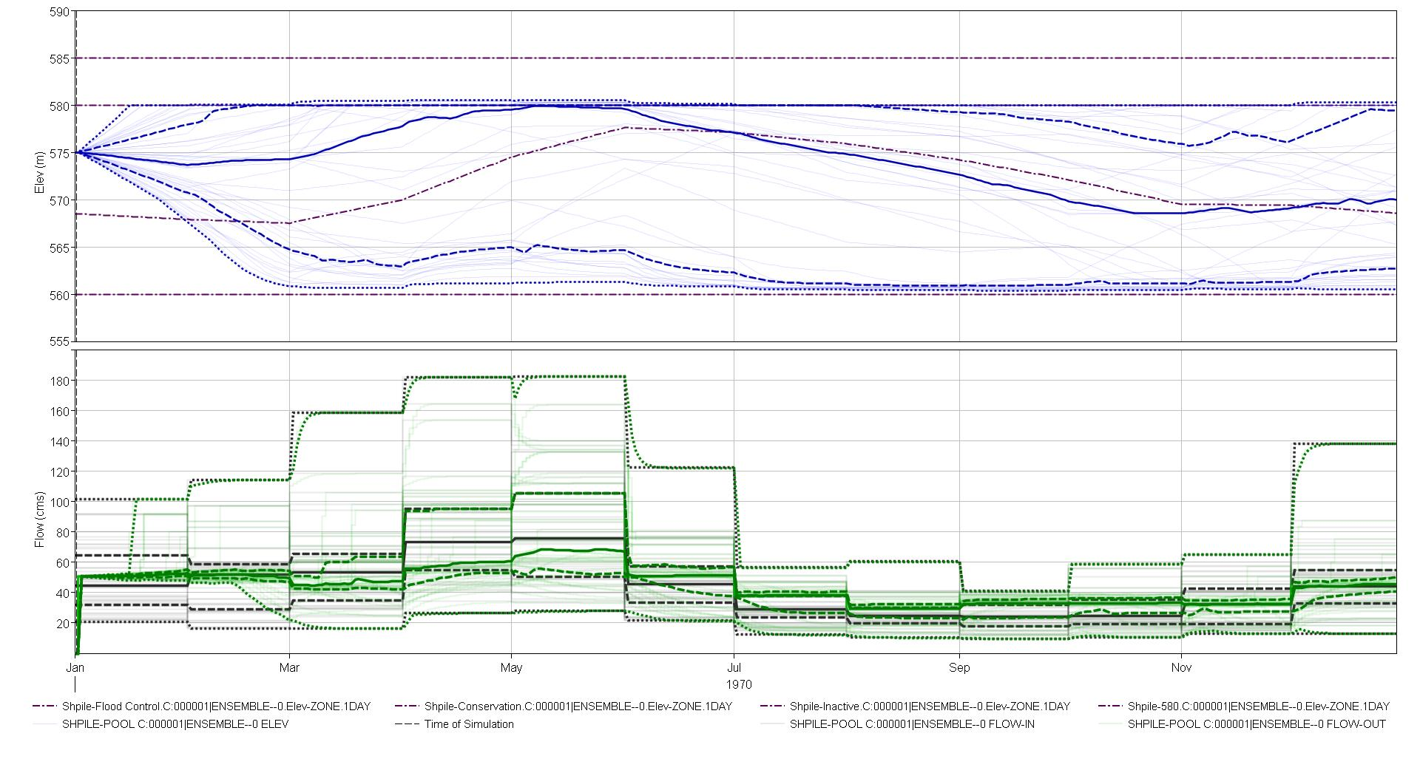
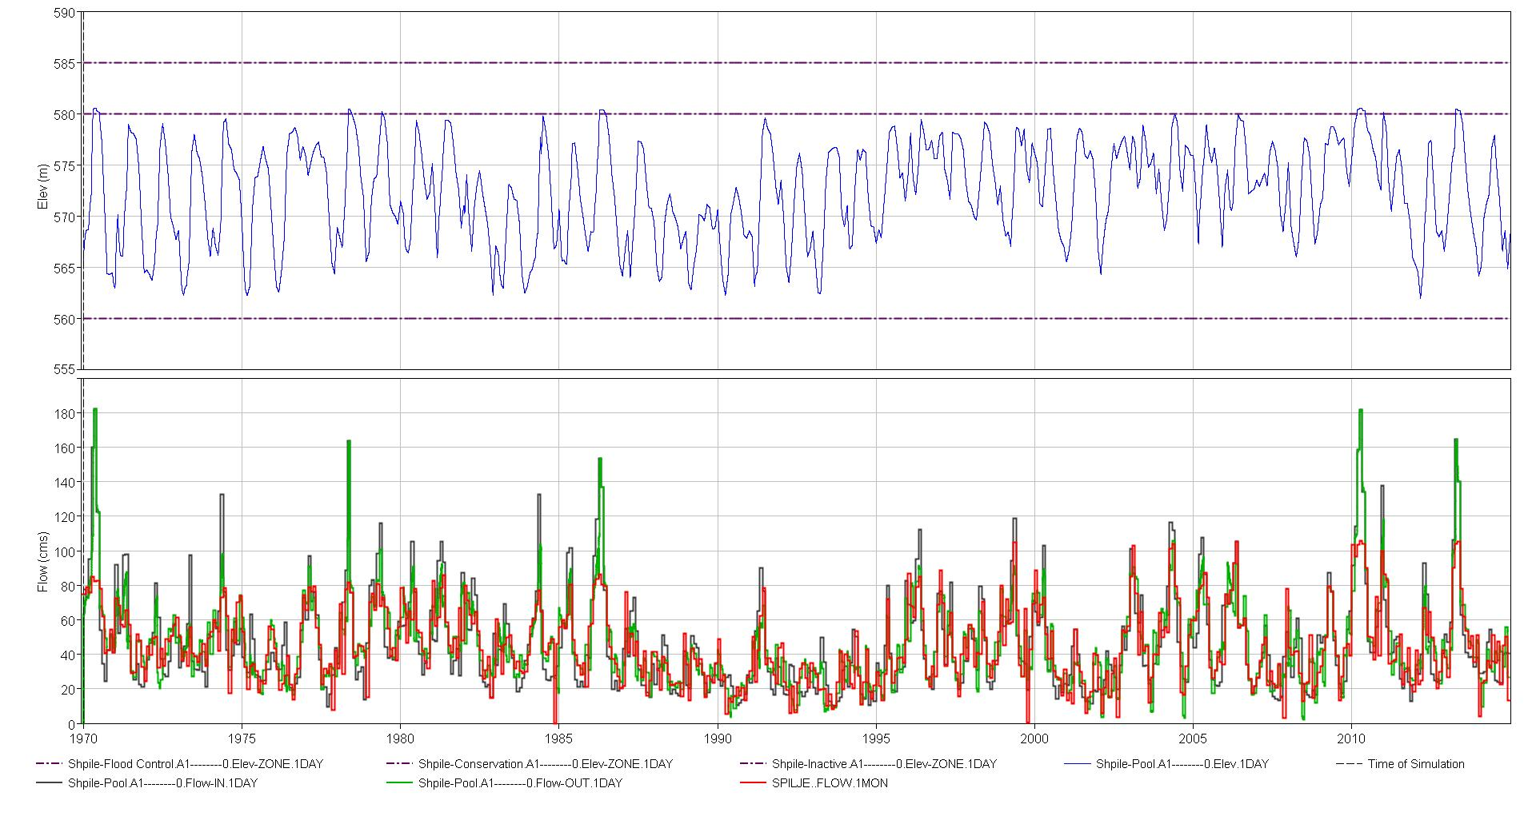
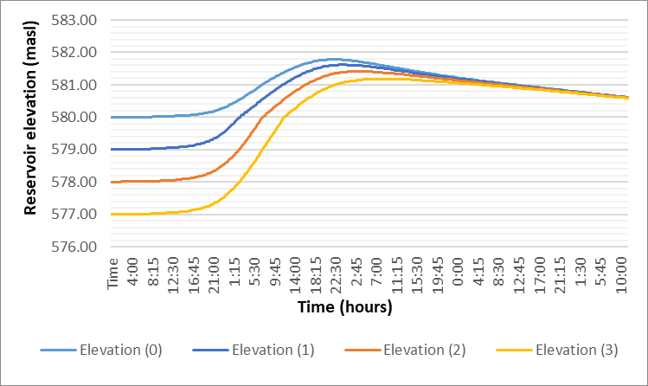
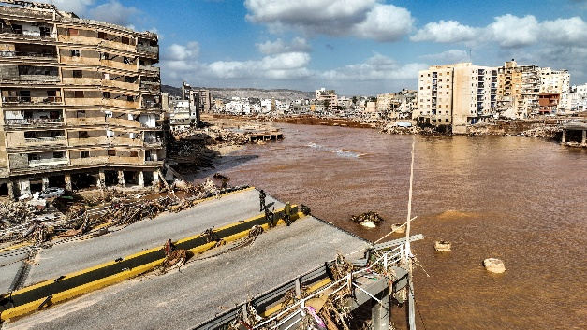
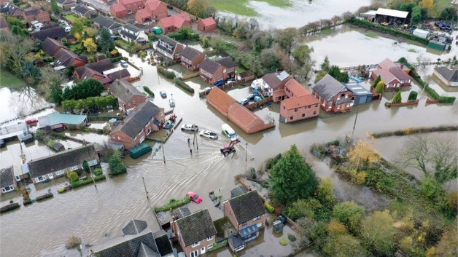
DEVELOPMENT OF THE SECTOR FLOOD RISK MANAGEMENT POLICIES IN THE DRIN BASIN (AGRICULTURE AND ENERGY)
Technical analysis of the Hydropower sector related to floods and climate change
Reservoir Simulation Modelling
WORKING SCENARIOS - test the flood protection capacity of the reservoir and its impact on energy production
Keep flood reserved volume - constant storage during the whole year or seasonal reservoir guide curve
Peak flow retention capacity analysis
Summer Floods Libya, 2023
Summer Floods Slovenia, 2023
Calculated over 50 scenarios -
stochastic and deterministic modelling

Slide 10
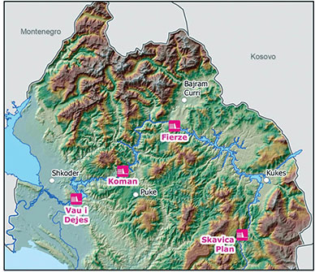
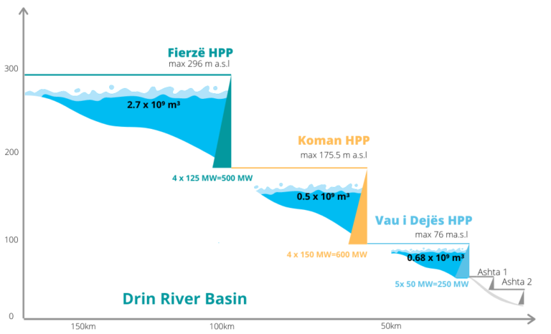
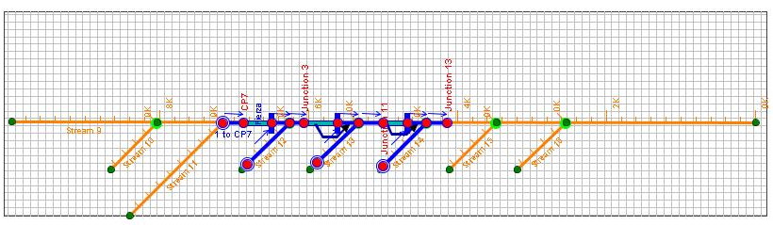
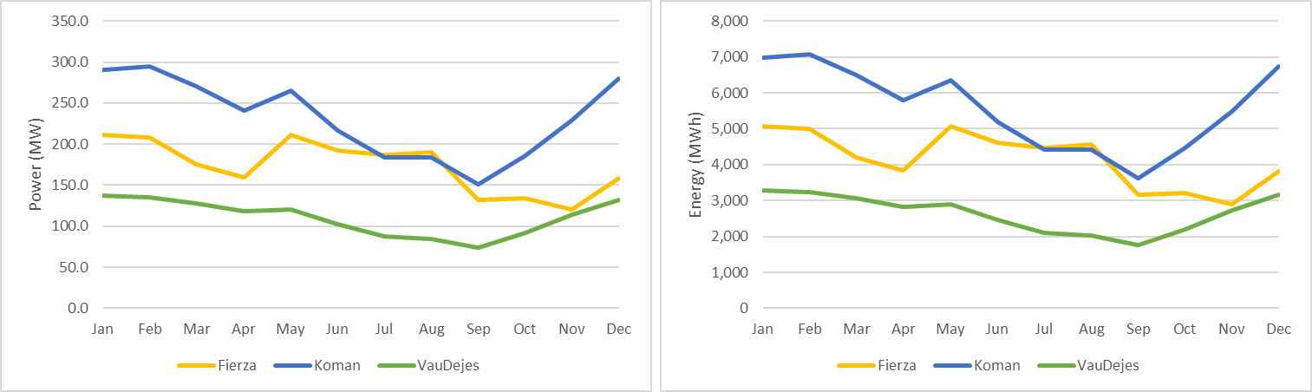
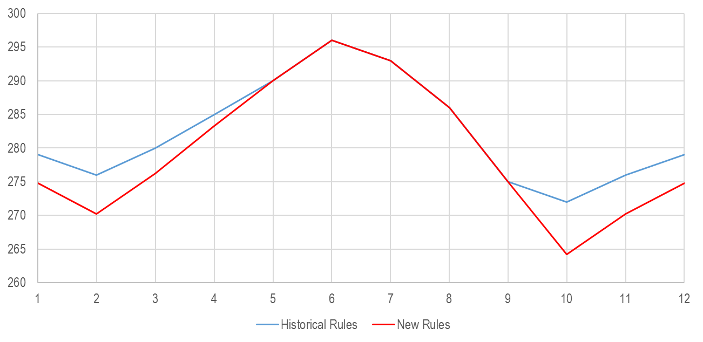
DEVELOPMENT OF THE SECTOR FLOOD RISK MANAGEMENT POLICIES IN THE DRIN BASIN (AGRICULTURE AND ENERGY)
Technical analysis of the Hydropower sector related to floods and climate change
WORKING SCENARIOS - test the flood protection capacity of the reservoir and its impact on energy production
Keep flood reserved volume - constant storage during the whole year or seasonal reservoir guide curve
The model was Calibrated using average annual values
The proposed methodology was applied in the Albanian part of the Project area !
Koman HPP
Vau i Dejes HPP
Fierza HPP
Cascade reservoir simulation model

Slide 11
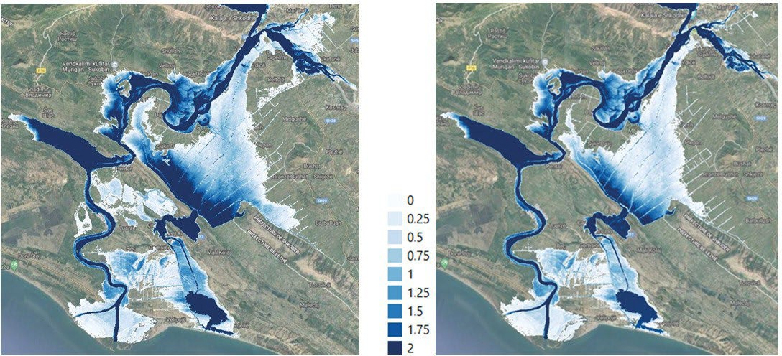
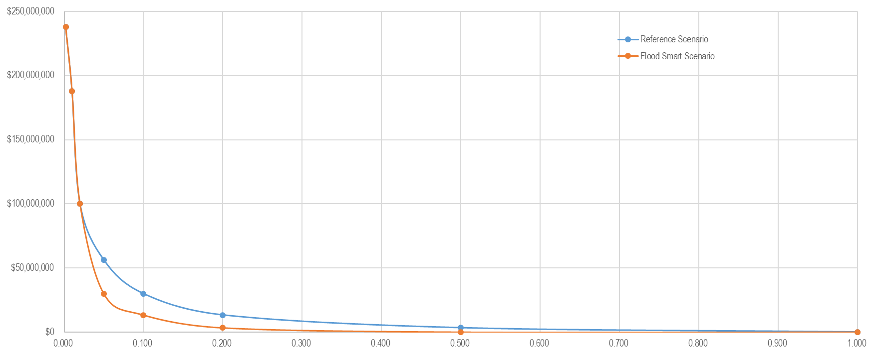
DEVELOPMENT OF THE SECTOR FLOOD RISK MANAGEMENT POLICIES IN THE DRIN BASIN (AGRICULTURE AND ENERGY)
Technical analysis of the Hydropower sector related to floods and climate change
NEXT STEPS
Introducing conditional probability (temporal scale, elevation, Qmax)
Analysis of the impact of potential flood-smart operations in NMK on the management of the Albanian Drin Cascade
Analysis of the impact of flood-smart operations on the reduction of produced energy
Analysis of the CC impact on potential future energy production
Analysis of the impact of flood-smart operations on flood risk reduction
Analysis of the impact of flood-smart operations on the reduction of flood damage
Economic analysis of possible benefits and losses
The avoided annual damage (AAD): The benefits from flood management projects
VS
Energy lost: Reduction of energy production as a result of flood management measures

Slide 12
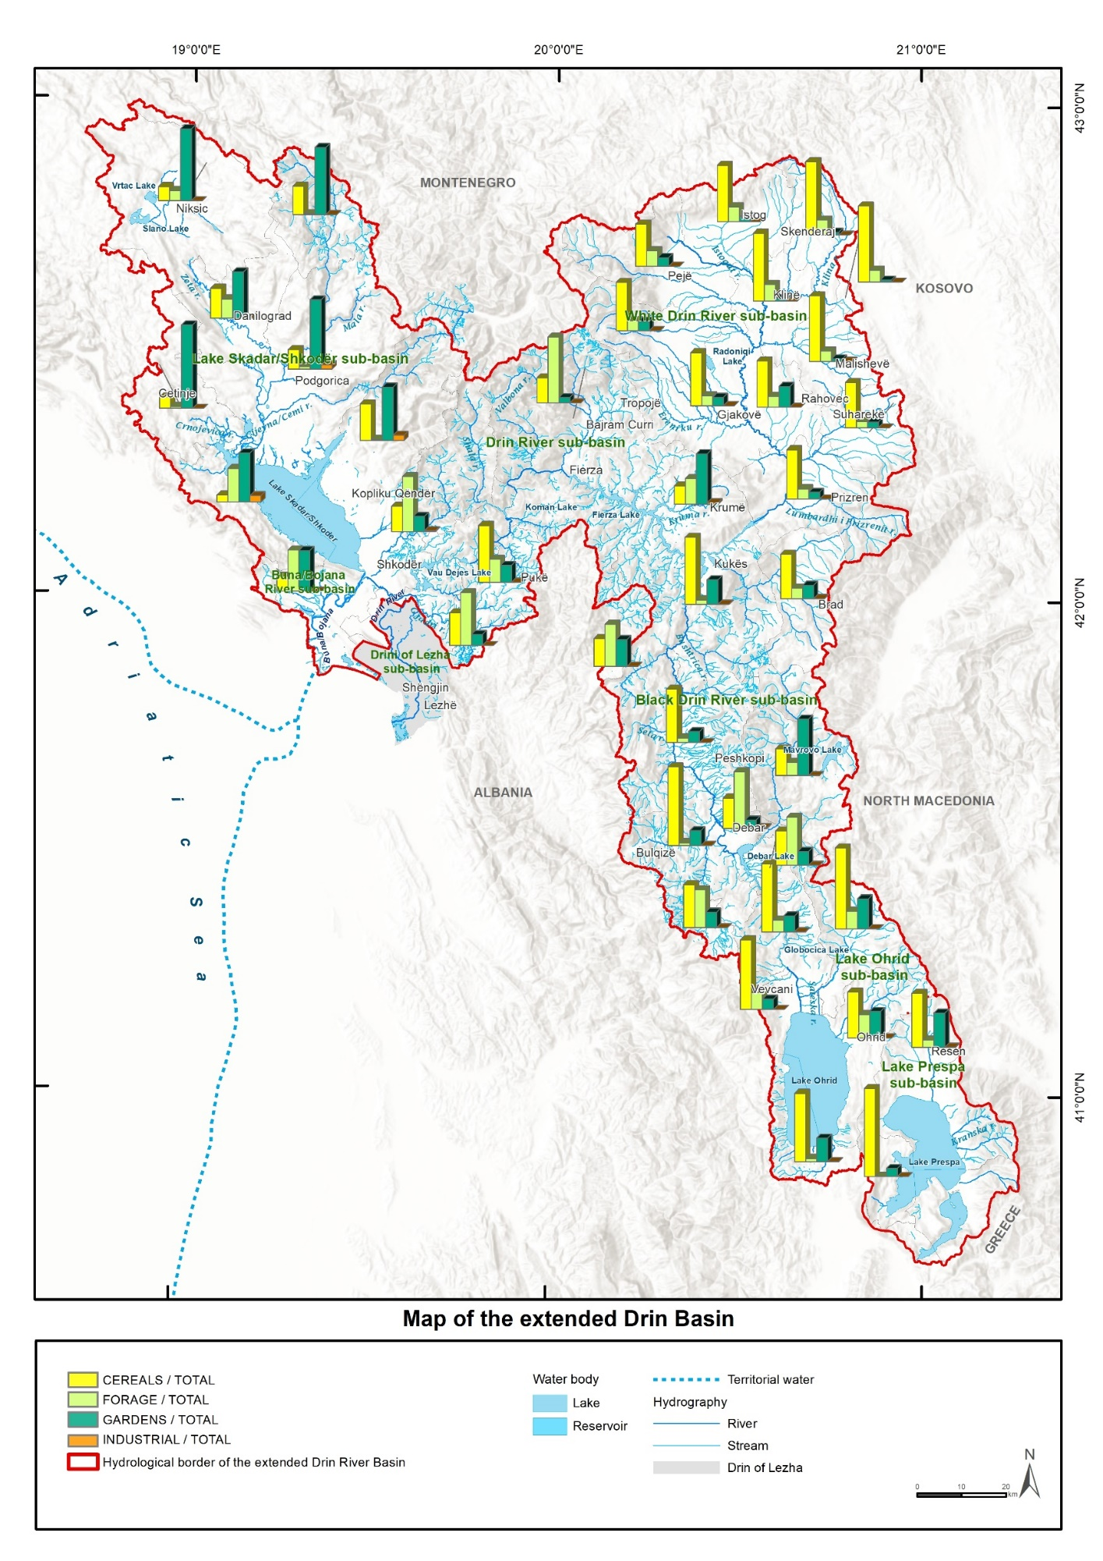
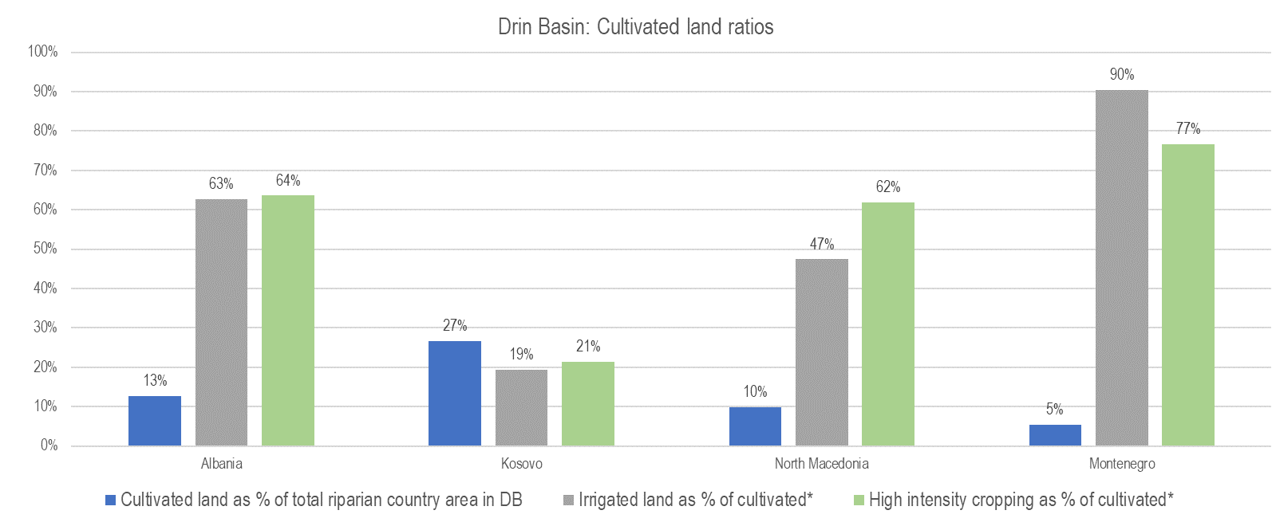
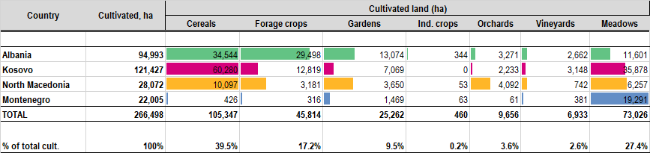
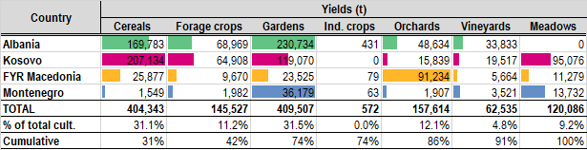
DEVELOPMENT OF THE SECTOR FLOOD RISK MANAGEMENT POLICIES IN THE DRIN BASIN (AGRICULTURE AND ENERGY)
Technical analysis of the agriculture sector related to floods and climate change
The role played by the agriculture sector in the economies of DRB riparians remains critically important (its share is from 8-20 % of annual GDP)
Temperature will increase and precipitation will become more variable in DRB as a result of climate change.
The direct temperature and precipitation effects of future climate change on crops are mixed.
Climate change is projected to have the potential to improve yields of wheat and irrigated alfalfa, to reduce yields for grapes, and to have relatively modest effects on other crops.
Recant and more detailed studies under AF project assessed annual average crop losses in the pre-selected flood areas (10 riskiest communities in Albania and North Macedonia) to be a significant part of overall flood: cc 1,8 mil EUR assuming flooding thresholds are 1 in 2 years).

Slide 13
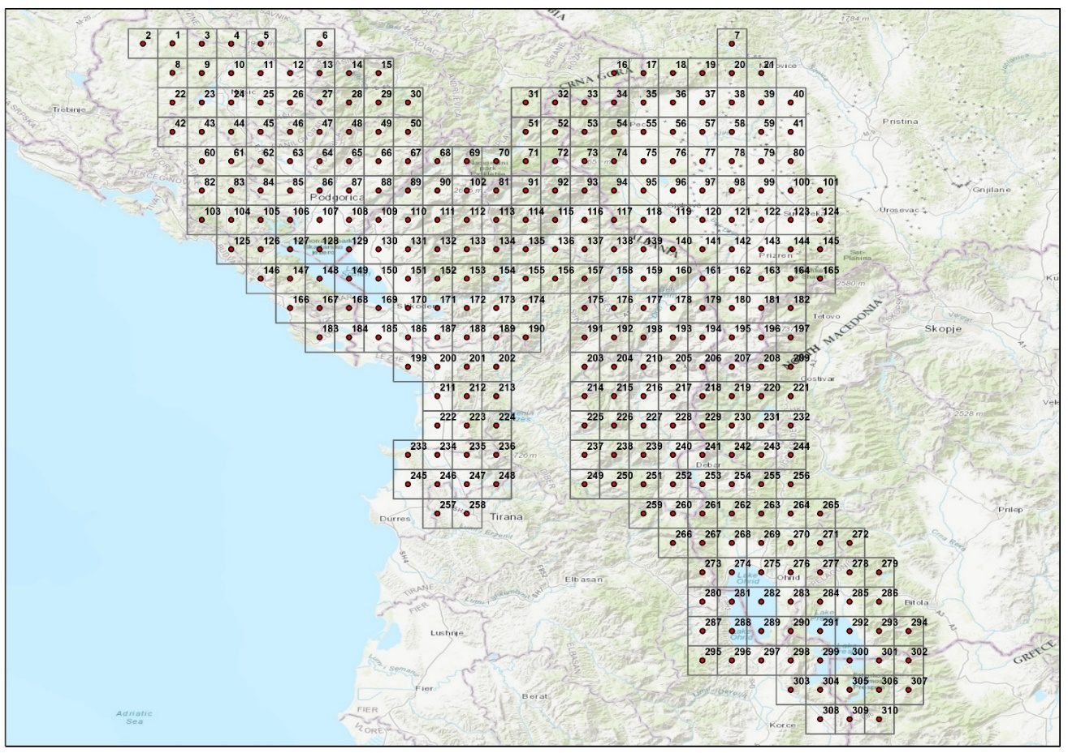
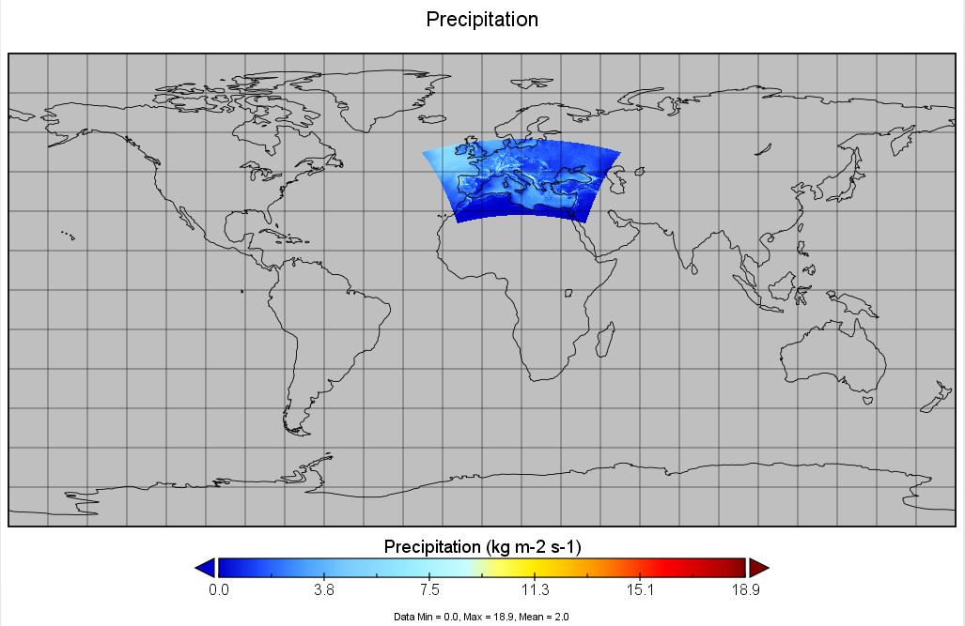
Climate and climate changes scenarios data
DEVELOPMENT OF THE SECTOR FLOOD RISK MANAGEMENT POLICIES IN THE DRIN BASIN (AGRICULTURE AND ENERGY)
Technical analysis of the agriculture sector related to floods and climate change
Climate change poses significant challenges to agriculture in the Mediterranean region. Rising temperatures, water scarcity, changing precipitation patterns, and increased frequency of extreme weather events are some of the key impacts affecting agricultural productivity.
In Med-CORDEX, 19 scenario runs have been performed with 11 different RCSM configurations and by 8 different institutes. Med-CORDEX initiative has been proposed by the Mediterranean climate research community as a follow-up of previous and existing initiatives. Med-CORDEX takes advantage of new very high-resolution Regional Climate Models (RCM). For spatial resolution approx. 12 km horizontal resolution and for temporal coverage 1971-2005 for the historical run will be used.
List of variables available
Med-CORDEX grid cell domain for DRB
Two scenarios will be covered. The RCP4.5 and the RCP8.5 scenarios in which ALADIN-Climate is driven by the RCP4.5 (resp. RCP8.5) scenario run made with CNRM-CM5. The period covered is 2006–2100 (in decadal time periods). RCP4.5 and RCP8.5 corresponds to the naming of two of the new climate change scenarios (Radiative Concentration Pathway scenario) used in CMIP5 and in the IPCC-AR5.
Med-CORDEX domain

Slide 14

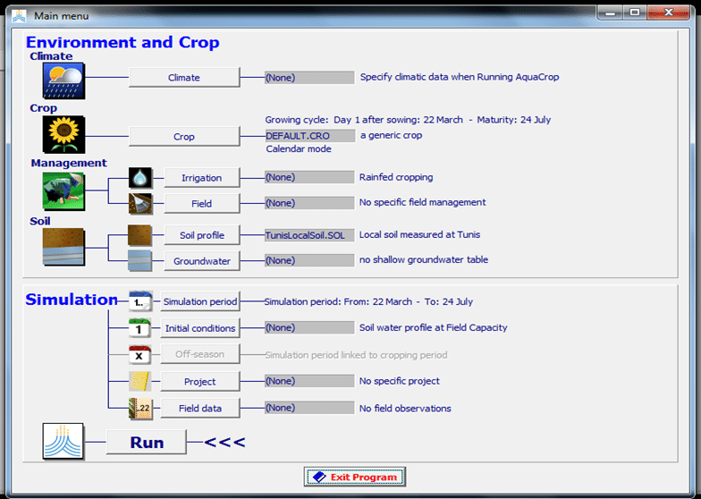
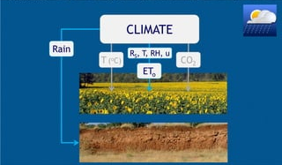
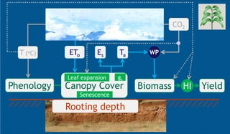
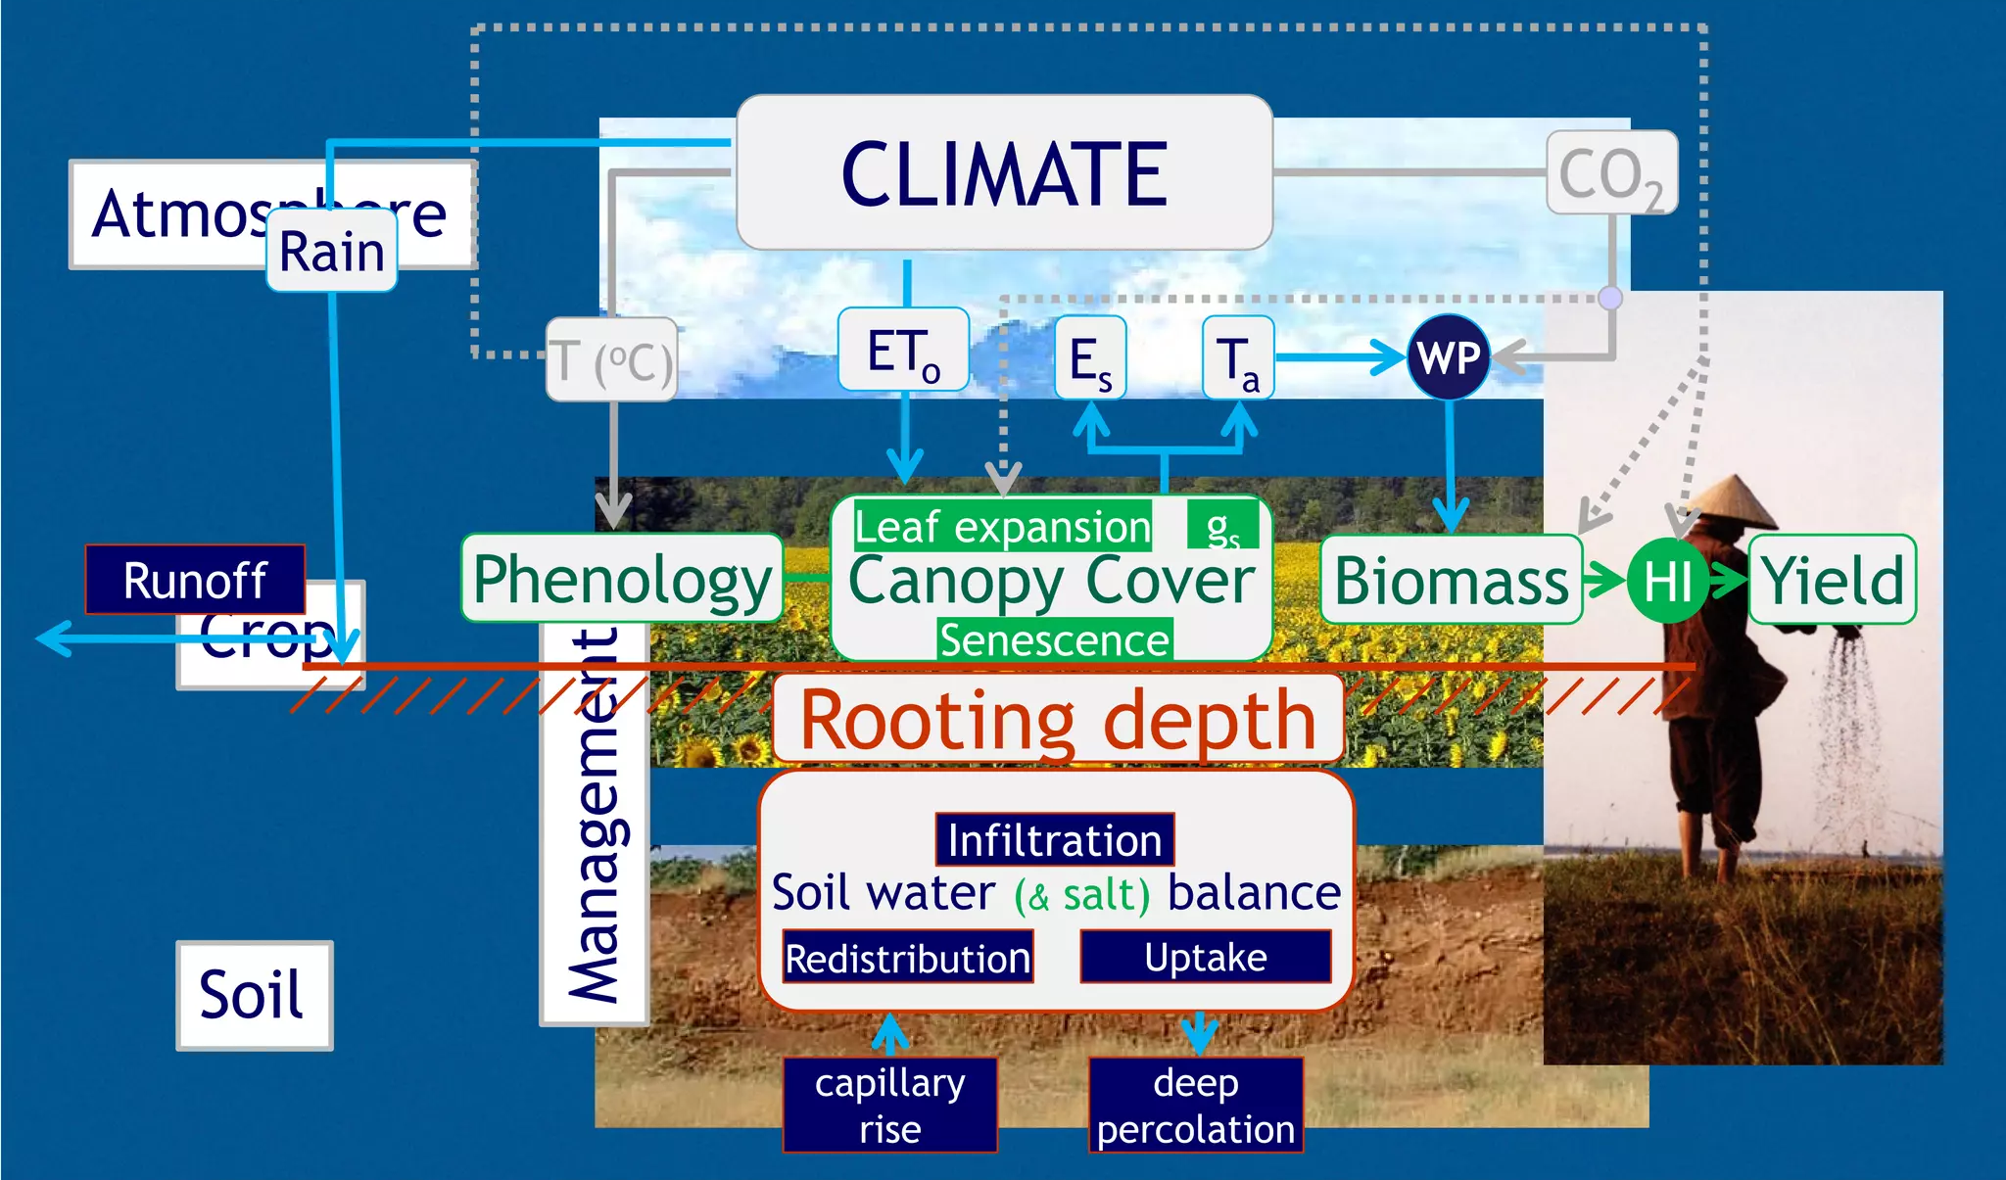
AQUACROP for assessment the impact on agricultural production and yield response to climate changes
DEVELOPMENT OF THE SECTOR FLOOD RISK MANAGEMENT POLICIES IN THE DRIN BASIN (AGRICULTURE AND ENERGY)
Technical analysis of the agriculture sector related to floods and climate change
The effects of climate change on crop yield can be converted into the yield response using the crop model.
AquaCrop is a crop growth model developed by FAO's Land and Water Division to address food security and assess the effect of the environment and management on crop production.
The main objective is to model and asses the effect of climate change on food production by running AquaCrop with both historical and future weather conditions (climate change scenarios).
AquaCrop simulates yield response to water of herbaceous crops, and is particularly suited to address conditions where water is a key limiting factor in crop production.

Slide 15
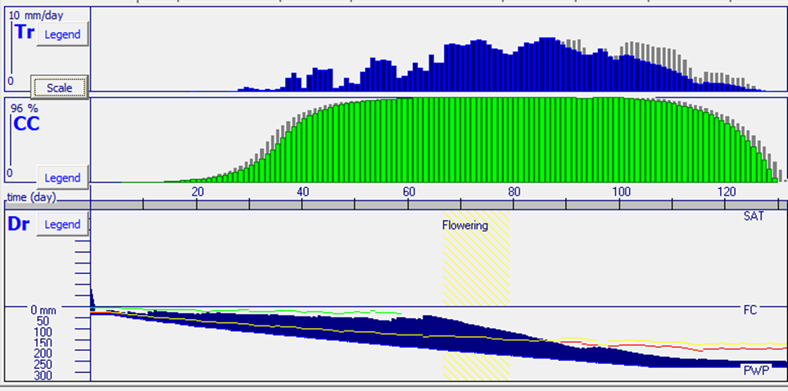
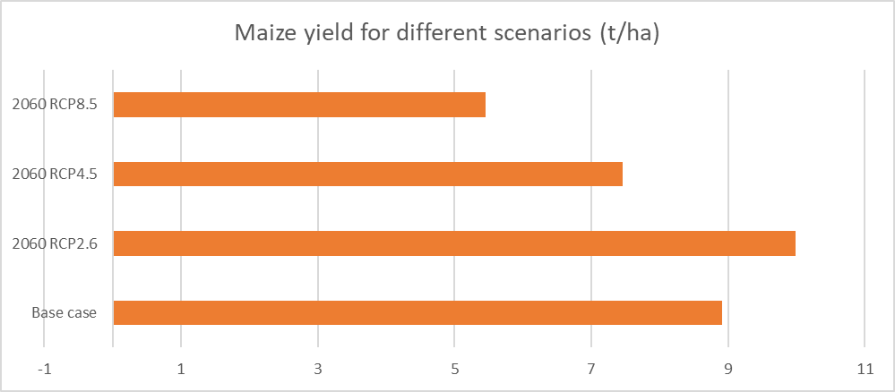

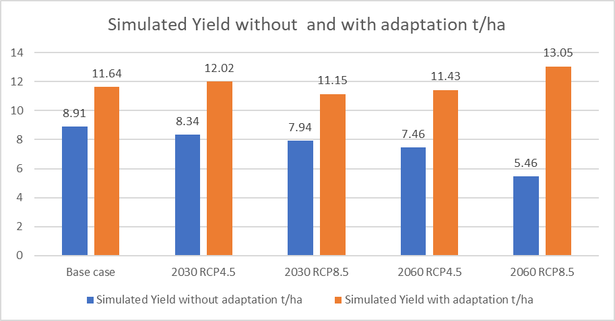
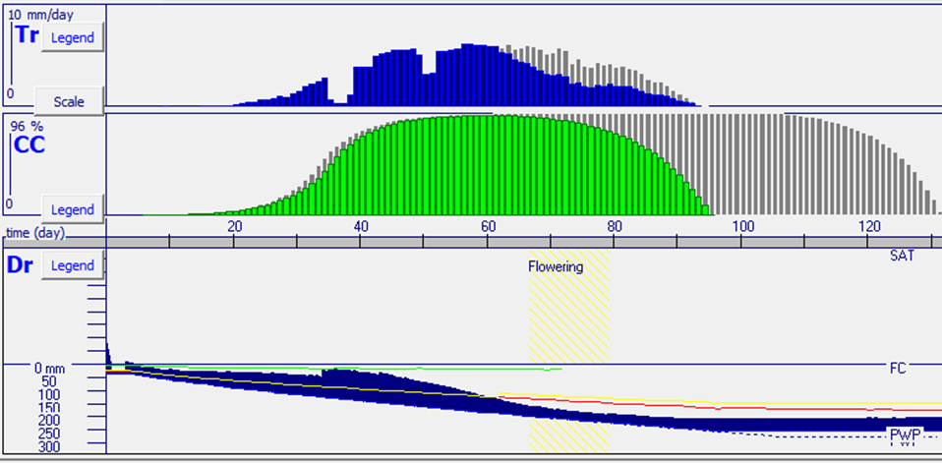
DEVELOPMENT OF THE SECTOR FLOOD RISK MANAGEMENT POLICIES IN THE DRIN BASIN (AGRICULTURE AND ENERGY)
Technical analysis of the agriculture sector related to floods and climate change
Example: Maize yield response to CC in NM and adaption measures applied
Water deficit influence on the crop growth in late stages
 | Simulated Irrigation water use in mm | Irrigation water productivity in kg/m3
Base case | 229.8 | 1.18
2030 RCP4.5 | 303.22 | 1.21
2030 RCP8.5 | 246.5 | 1.3
2060 RCP4.5 | 236.1 | 1.68
2060 RCP8.5 | 241.9 | 3.14
Water deficit influence of the crop growth in early stages
Tr – Transpiration, CC – Canopy cover, Dr- Root zone water depletion

Slide 16
DEVELOPMENT OF THE SECTOR FLOOD RISK MANAGEMENT POLICIES IN THE DRIN BASIN (AGRICULTURE AND ENERGY)
Flood Risk Management Policies
Flood prone areas
Hydrodynamic modeling
Flood risk analysis
Flood hazard mapping
Vulnerability
Flood risk models
Expected event based, damages and losses
Expected annual damages and losses
Exposure
Scenarios
Adaptation strategy
Technical measures
Non-technical measures
Multi Criteria Analysis
Cost-Benefit analysis
Stakeholder consultation
Current scenario
Climate change scenarios
Sectoral FRM policies
Sector of Hydropower
Technical analysis of the agriculture sector
Technical analysis of the hydroenergy sector
Sector of Agriculture
TASK 1
Prepare for development of the Sectoral policies, data collection and processing
TASK 2
Develop two technical studies on climate change impacts on energy (hydropower) and agriculture in the flood-prone areas of the Drin River basin
TASK 3
Develop sectoral FRM policies and any necessary enabling guidelines and/or tools for sectors of Agriculture and Energy (Hydropower)
Sector of Hydropower / Flood protection
Technical and non-technical measures for selected sites, for example: (1) Adopt operational strategies to reduce high flows, (2) Build additional storage capacity, (3) Measures for protecting critical infrastructure, (4) Adjust water management strategies, (5) Increase storage capacity, (6) Improve short and medium term water flow forecasts, (7) Sediment management, (8) Site ground installations outside hazard zones, (9) Improve insulator design.
Sector of Agriculture
Adaptation recommendations will have two objectives: to reduce exposure to the risk of damage and to develop the capacity to cope with unavoidable damages. For the Agricultural sector, the recommendation following the two objectives may include: (1) Change in the cropping pattern and (2) Crop diversification (climate and flood resilient corps), (3) Soil conservation measures (increasing retention capacities and decreasing soil erosion)

